Slide 1
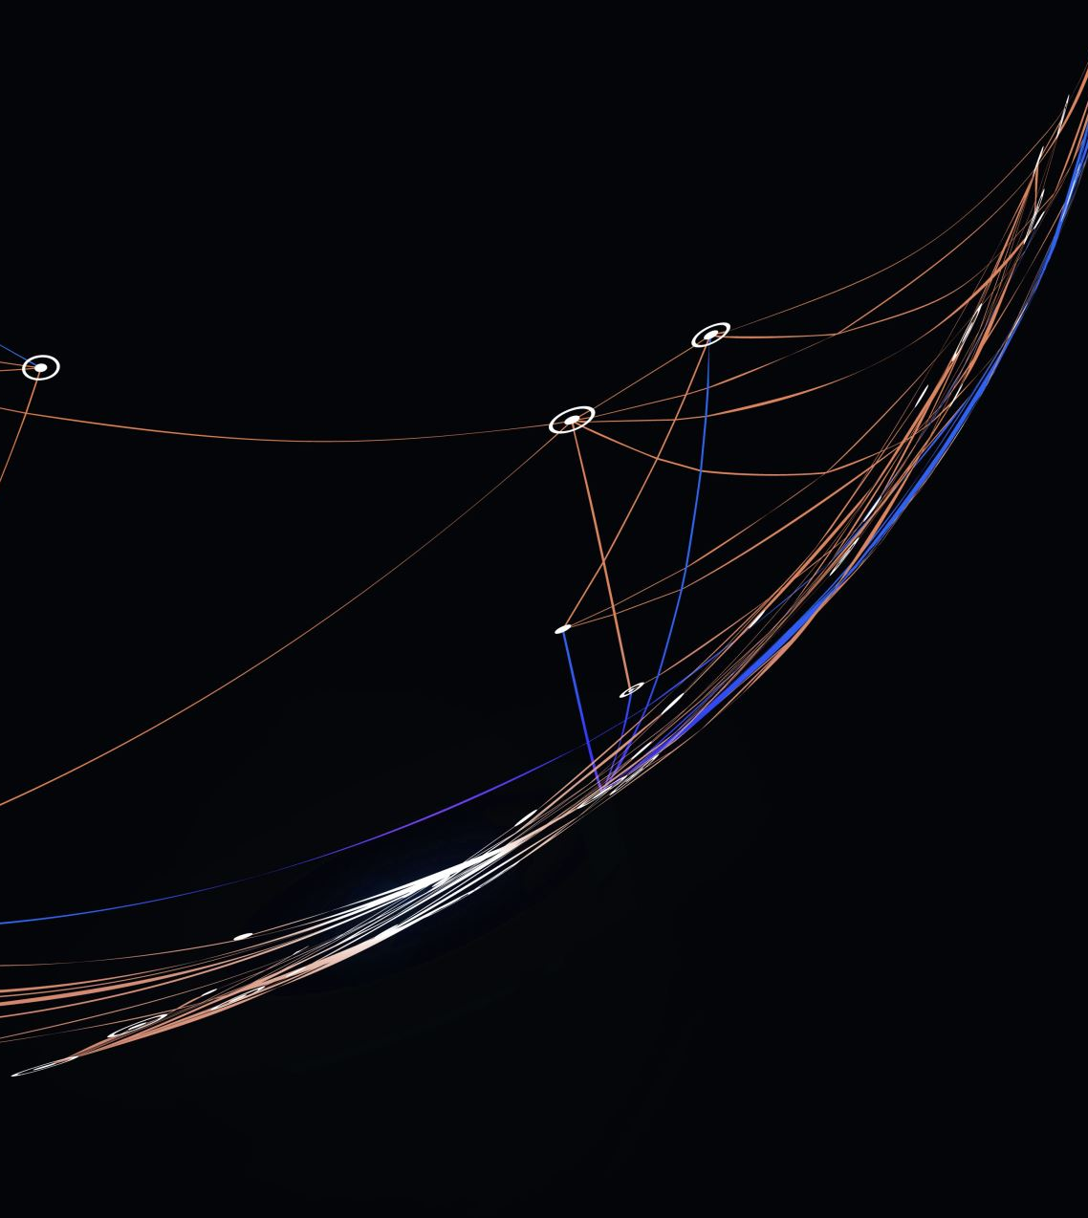
Payroll Automatization
Team 17

Slide 2

Background Case

Slide 3

Pain Point PoV
Multiple data output and input
Repeatable task but need a high accuracy
Repeating the same task each month

Slide 4
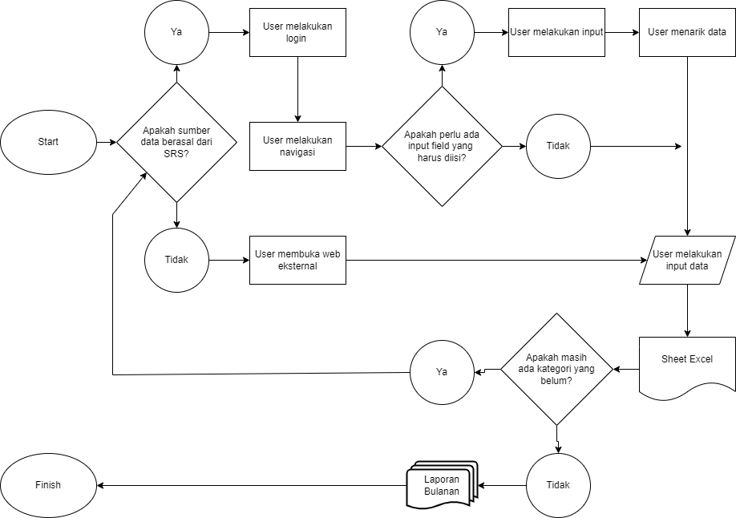
Existing Process Flow

Slide 5
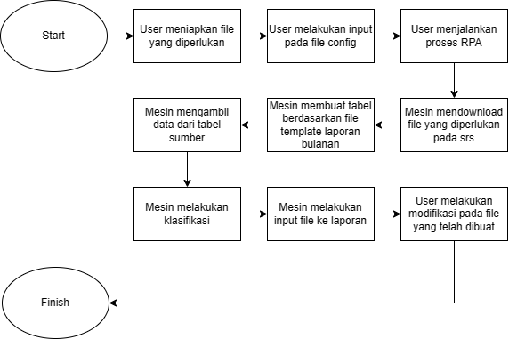
Scooping RPA

Slide 6

Impact Analysis
6 times faster than doing it manually
Close to none human failure
Costumizeable and easier task accomplishment

Slide 7
Important Notes
Shorten the code base
Streamline the process
Refine the database

Slide 8

Thankyou

